Slide 1
A Masterclass in Reproducibility
Warwick University – Jan 2019
Dr Tom August

Slide 2
Introductions
Me
  Computational Ecologist at the Centre for Ecology and Hydrology
  10 years practical experience in reproducible research
You
  Name
  Course
  Experience with R & Rstudio
  What do you want to get out of the day

Slide 3
Course Aims
Know what reproducibility is
Know why reproducibility is important
Know how to implement reproducibility in your own work
You wont be an expert in reproducibility

Slide 4
Timetable

Slide 5
Course materials
Slides
Practical's
Other materials
All these are available online and we download them later
Much of this material is reproduced, using resources shared openly by others, notably Karl Broman, Coding Club, Hadley Wickham

Slide 6

A test of reproducibility
Notes:
Demonstrate how it is done
60 seconds to reproduce
What made it hard to reproduce
What could we have done to make it easier to reproduce?
These are themes we are going to come back to time and again

Slide 7
Some definitions
American Statistical Association
  Reproducibility: A study is reproducible if you can take the original data and the computer code used to analyze the data and reproduce all of the numerical findings from the study.
  Replicability: This is the act of repeating an entire study, independently of the original investigator without the use of original data (but generally using the same methods).
Other terms: Repeatable, Reusable, Correct

Slide 8
What are the hallmarks of reproducible research?
Analyses that are well documents
Files that are well organised
Processes that are coded, rather than carried out manually
Data that is easy to find and access
Edits and versions are easy to track

Slide 9
Why is reproducibility a good thing?
For us?
  Your most frequent collaborator is your past self
  Your work is more likely to be used by others if it is reproducible
  You are more likely to avoid errors
  You will save time in the long run (“Can you re-run this?”)
For ‘science’
  It is easier to trust studies that are reproducible
  Methods can be shared for effectively
  Speeds up the scientific process

Slide 10
Why is reproducibility a good thing?
“To much fanfare, the journal Science published promising developments in stem cell research only to learn months later that the findings were bogus (1). Lancet editors retracted a paper on oral cancer when the editors learned that the researchers had fabricated their data (2). The New England Journal of Medicine published a statement of concern on a drug toxicity study when evidence suggested that the authors had withheld important adverse outcomes (3). Incidents of authors who have not disclosed potential conflicts of interest have prompted JAMA to reinforce its disclosure policies (4–6). Here at Annals, we retracted an article after learning that the lead author had fabricated the data. (7–9)” – Laine et al 2007

Slide 11
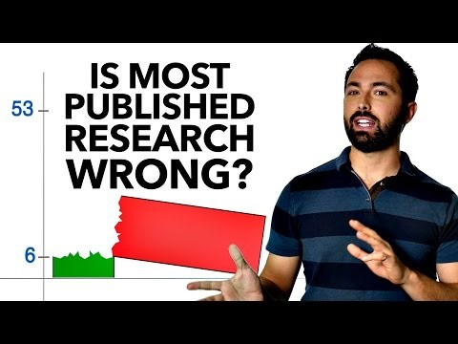

Slide 12
How do we make our research reproducible?
Order files and folders and track your edits
  Git and Github
Code everything you do
  R, Rstudio
Document as you go
  Code commenting, Rmarkdown
Make your code reusable
  R functions, R packages, Rmarkdown
Make your results easy to find
  Shiny

Slide 13




Slide 14
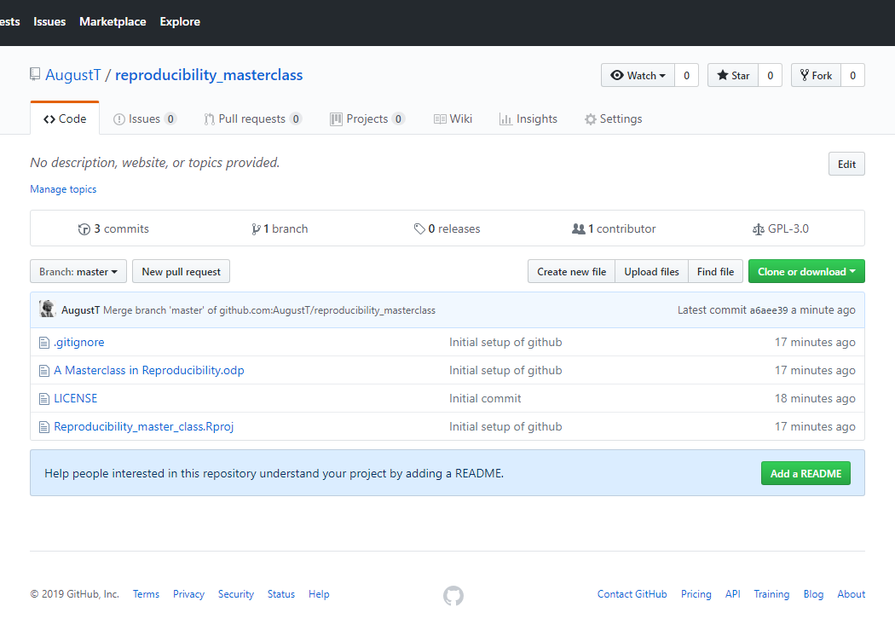
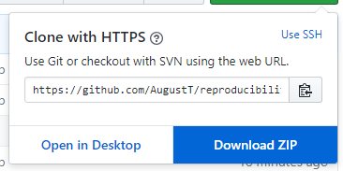
Getting access to the course materials

Slide 15
Files and folders

Slide 16
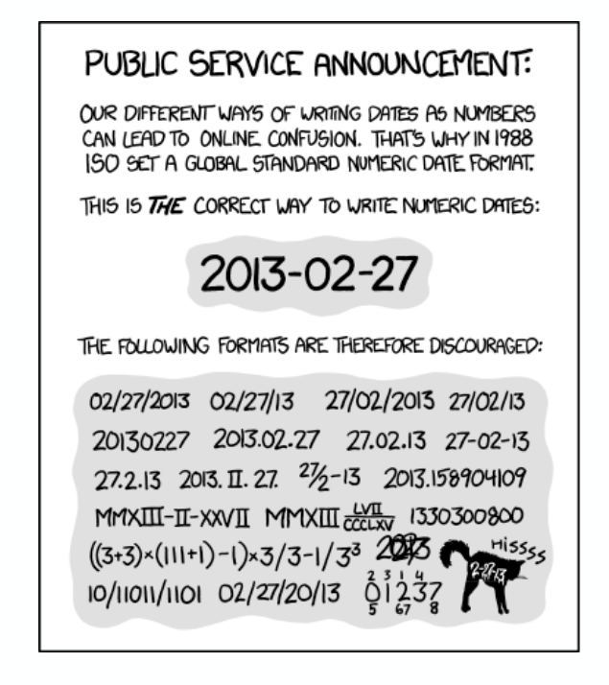
Good practise for organisation
Have one folder per project
Organise your files into folders. Typically I have:
  Data
  Code
  Results
Name files clearly, they should be human-readable:
  Data.csv / Bat_data_2018.csv
Use plain text files where possible, avoid proprietary formats
  Bat_data_2018.xlsx / Bat_data_2018.csv
Add dates to file names, especially data, think about order
  Group_data_ 20190111.csv
Backup your work
Be consistent
XKCD

Slide 17
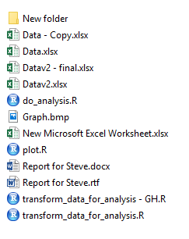

Practical
5 minutes

Slide 18
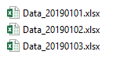
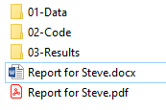
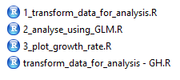
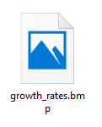
Practical

Slide 19
Coding etiquette

Slide 20
Coding etiquette
Code should be human readable
Reading code should not give you a headache
A good resource: Hadley Wickham's R Style Guide

Slide 21
Coding etiquette
Variables store data and should be nouns [bat_counts], functions do things and should be verbs [mean].
Names should be short and descriptive with ‘_’ or CamelCase used to separate words in names.
You will find conflicting advise online and between programmers. Hadley Wickham doesn’t like CamelCase:
BAD
first_day_of_the_month
DayOne
dayone
djm1
GOOD
day_one
day_1

Slide 22
Coding etiquette
Use spaces in your code to make it easy to read and understand. You are not going to run out of space so don’t cram everything together.
average<-mean(feet/12+inches,na.rm=TRUE)
average <- mean(feet / 12 + inches, na.rm = TRUE)

Slide 23
Coding etiquette
When using loops or if statements in R You can end up with ‘nested’ code. Using indentation is key to making this easy to read.
if (y == 0) {
log(x)
} else {
if(x == 1){
y ^ x
} else {
x ^ y
}
}
if (y == 0) {
log(x)
} else {
if(x == 1){
y ^ x
} else {
x ^ y
}
}

Slide 24
Coding etiquette
Avoid long lines, that can make it harder to read your code.
My_data <- read.csv(path = ‘mydata.csv’, header = TRUE, sep = ‘,’, stringsAsFactors = FALSE)
My_data <- read.csv(path = ‘mydata.csv’,
header = TRUE,
sep = ‘,’,
stringsAsFactors = FALSE)

Slide 25
Coding etiquette
Clearly document what your code does, and break it into sections:
># Comments start with a ‘#’ and are ignored
># when you run your code
>
>X <- 1:10
># Average the values in X
>mean(X)

Slide 26
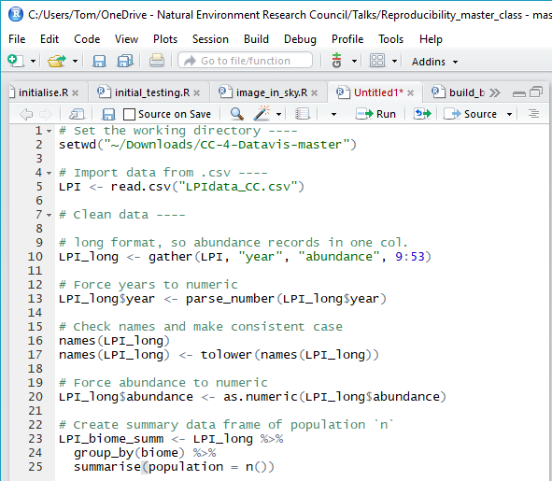
Coding etiquette
Clearly document what your code does.
How much is enough?
# Analysis of 2019 finances
# Tom August
# 2019-01-05
# 1. Load libraries
…
# 2. Load data
…
# 3. Reformat data
…
…
…
# 10. Save results
…

Slide 27
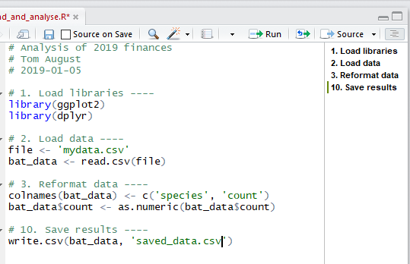
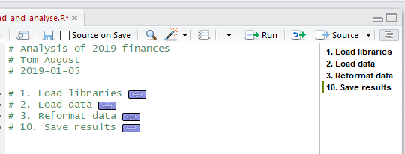
Coding etiquette
Rstudio has some features that can help you to keep organised

Slide 28
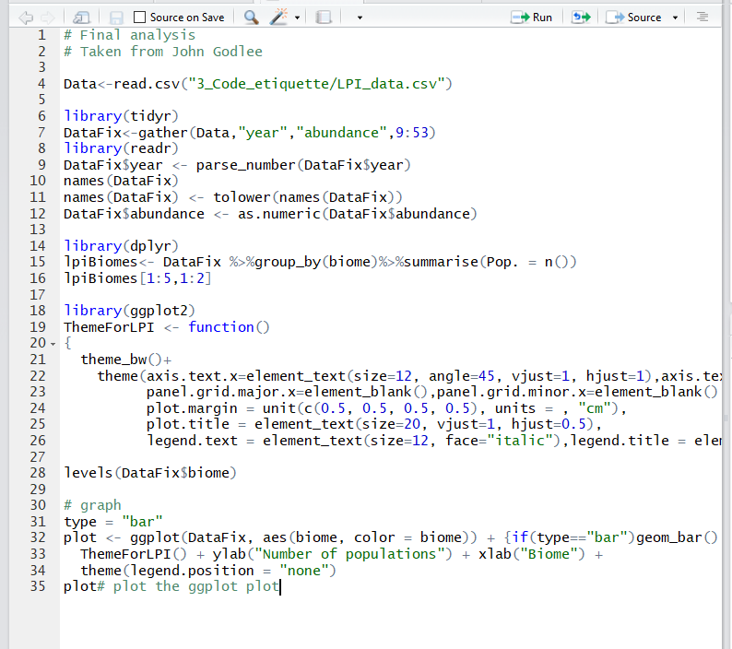
Practical
Appropriate names
Spacing
Descriptive comments
Ordered sections
Avoid long lines
10 minutes

